Slide 1
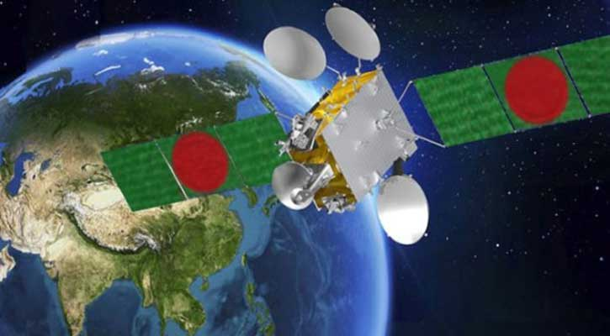
Satellite Communications
SWE 425: Telecommunication Engineering with Lab
Md. Habibur Rahman
Lecturer,
Dept. of SWE, DIU

Slide 2
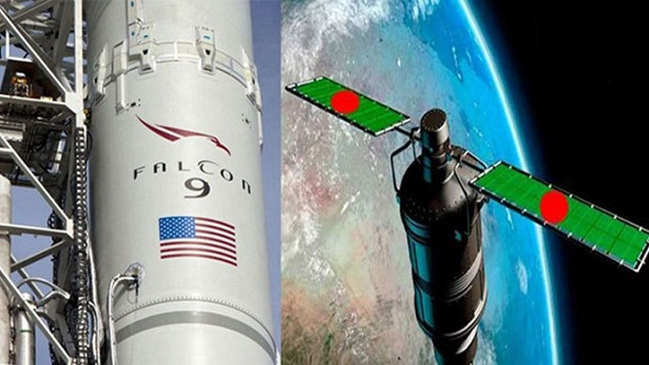
Overview
Basics of Satellites
Types of Satellites
Capacity Allocation
An artificial body placed in orbit around the earth to collect information or for communication.

Slide 3
Basics: How do Satellites Work
Two Stations on Earth want to communicate through radio broadcast but are too far away to use conventional means.
The two stations can use a satellite as a relay station for their communication
One Earth Station sends a transmission to the satellite. This is called a Uplink.
The satellite Transponder converts the signal and sends it down to the second earth station. This is called a Downlink.

Slide 4
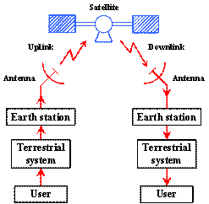
Notes:
0

Slide 5
Basics: Advantages of Satellites
The advantages of satellite communication over terrestrial communication are:
The coverage area of a satellite greatly exceeds that of a terrestrial system.
Transmission cost of a satellite is independent of the distance from the center of the coverage area.
Satellite to Satellite communication is very precise.
Higher Bandwidths are available for use.

Slide 6
Basics: Disadvantages of Satellites
The disadvantages of satellite communication:
Launching satellites into orbit is costly.
Satellite bandwidth is gradually becoming used up.
There is a larger propagation delay in satellite communication than in terrestrial communication.

Slide 7
Basics: How Satellites are used
Service Types
Fixed Service Satellites (FSS)
Example: Point to Point Communication
Broadcast Service Satellites (BSS)
Example: Satellite Television/Radio
Also called Direct Broadcast Service (DBS).
Mobile Service Satellites (MSS)
Example: Satellite Phones
Notes:
The Text Book makes an odd choice in calling DBS BSS (BSS is actually the abbreviation used for Boeing Satellite Service).
These distinctions aren’t set in stone. For example, FSS satellites used to be used for broadcasting.

Slide 8
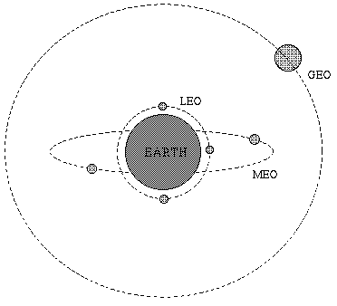
Types of Satellites
Satellite Orbits
GEO
LEO
MEO
Frequency Bands

Slide 9
Geostationary Earth Orbit (GEO)
These satellites are in orbit 35,863 km above the earth’s surface along the equator.
Objects in Geostationary orbit revolve around the earth at the same speed as the earth rotates. This means GEO satellites remain in the same position relative to the surface of earth.

Slide 10
GEO (cont.)
Advantages
A GEO satellite’s distance from earth gives it a large coverage area, almost a fourth of the earth’s surface.
GEO satellites have a 24 hour view of a particular area.
These factors make it ideal for satellite broadcast and other multipoint applications.

Slide 11
GEO (cont.)
Disadvantages
A GEO satellite’s distance also cause it to have both a comparatively weak signal and a time delay in the signal, which is bad for point to point communication.
GEO satellites, centered above the equator, have difficulty broadcasting signals to near polar regions

Slide 12
Low Earth Orbit (LEO)
LEO satellites are much closer to the earth than GEO satellites, ranging from 500 to 1,500 km above the surface.
LEO satellites don’t stay in fixed position relative to the surface, and are only visible for 15 to 20 minutes each pass.
A network of LEO satellites is necessary for LEO satellites to be useful

Slide 13
LEO (cont.)
Advantages
A LEO satellite’s proximity to earth compared to a GEO satellite gives it a better signal strength and less of a time delay, which makes it better for point to point communication.
A LEO satellite’s smaller area of coverage is less of a waste of bandwidth.

Slide 14
LEO (cont.)
Disadvantages
A network of LEO satellites is needed, which can be costly
LEO satellites have to compensate for Doppler shifts cause by their relative movement.
Atmospheric drag effects LEO satellites, causing gradual orbital deterioration.

Slide 15
Medium Earth Orbit (MEO)
A MEO satellite is in orbit somewhere between 8,000 km and 18,000 km above the earth’s surface.
MEO satellites are similar to LEO satellites in functionality.
MEO satellites are visible for much longer periods of time than LEO satellites, usually between 2 to 8 hours.
MEO satellites have a larger coverage area than LEO satellites.

Slide 16
MEO (cont.)
Advantage
A MEO satellite’s longer duration of visibility and wider footprint means fewer satellites are needed in a MEO network than a LEO network.
Disadvantage
A MEO satellite’s distance gives it a longer time delay and weaker signal than a LEO satellite, though not as bad as a GEO satellite.

Slide 17
Frequency Bands
Different kinds of satellites use different frequency bands.
L–Band: 1 to 2 GHz, used by MSS
S-Band: 2 to 4 GHz, used by MSS, NASA, deep space research
C-Band: 4 to 8 GHz, used by FSS
X-Band: 8 to 12.5 GHz, used by FSS and in terrestrial imaging, ex: military and meteorological satellites
Ku-Band: 12.5 to 18 GHz: used by FSS and BSS (DBS)
K-Band: 18 to 26.5 GHz: used by FSS and BSS
Ka-Band: 26.5 to 40 GHz: used by FSS

Slide 18
Passive Satellites
A satellite that only reflects signals from one Earth station to another, or from several Earth stations to several others.
It reflect the incident electromagnetic radiation without any modification or amplification.
It can't generate power, they simply reflect the incident power.

Slide 19
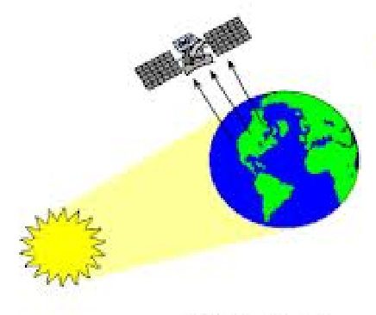
Passive Satellites
The first artificial passive satellite Echo-I of NASA was launched in August 1960.
Notes:
The principle of communication by passive satellite is based on the properties of distribution of electromagnetic waves from different surface areas.
Thus an electromagnetic wave incident on a passive satellite is scattered back towards the earth and a receiving station can receive the scattered wave. The passive satellites used in the early years of satellite communications were both artificial as well as natural.

Slide 20
Disadvantages
Earth Stations required high power to transmit signals.
Large Earth Stations with tracking facilities were expensive.
A global system would have required a large number of passive satellites accessed randomly by different users.
Control of satellites not possible from ground.
The large attenuation of the signal while traveling the large distance between the transmitter and the receiver via the satellite was one of the most serious problems.

Slide 21
Active Satellites
In active satellites, it amplify or modify and retransmit the signal from the earth.
Satellites which can transmit power are called active satellite.
Have several advantages over the passive satellites.
Require lower power earth station.
Less costly.
Not open to random use.
Directly controlled by operators from ground.

Slide 22
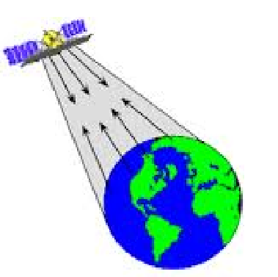
Active Satellites

Slide 23
World’s first active satellite was SCORE (Satellite Communication by Orbiting Relay Equipment)
Launched by US Air force in 1958.
At orbital height of 110 to 900 miles.
The first fully active satellite was Courier
Launched into an orbit of 600 - 700 mile,
By Department of Defense in 1960.
Notes:
It transmitted a pre-recorded message of Christmas Greetings from US President Eisenhower. However, the satellite did not function as a true repeater.
. It accepted and stored up to 360,000 Teletype words as it passed overhead and rebroadcast them to ground station farther along its orbit. It operated with 3 watts of on-board output power and it was also the first satellite to use solar cells for generating electrical power

Slide 24
Disadvantages
Requirement of larger and powerful rockets to launch heavier satellites in orbit.
Requirement of on-board power supply.
Interruption of service due to failure of electronics components

Slide 25
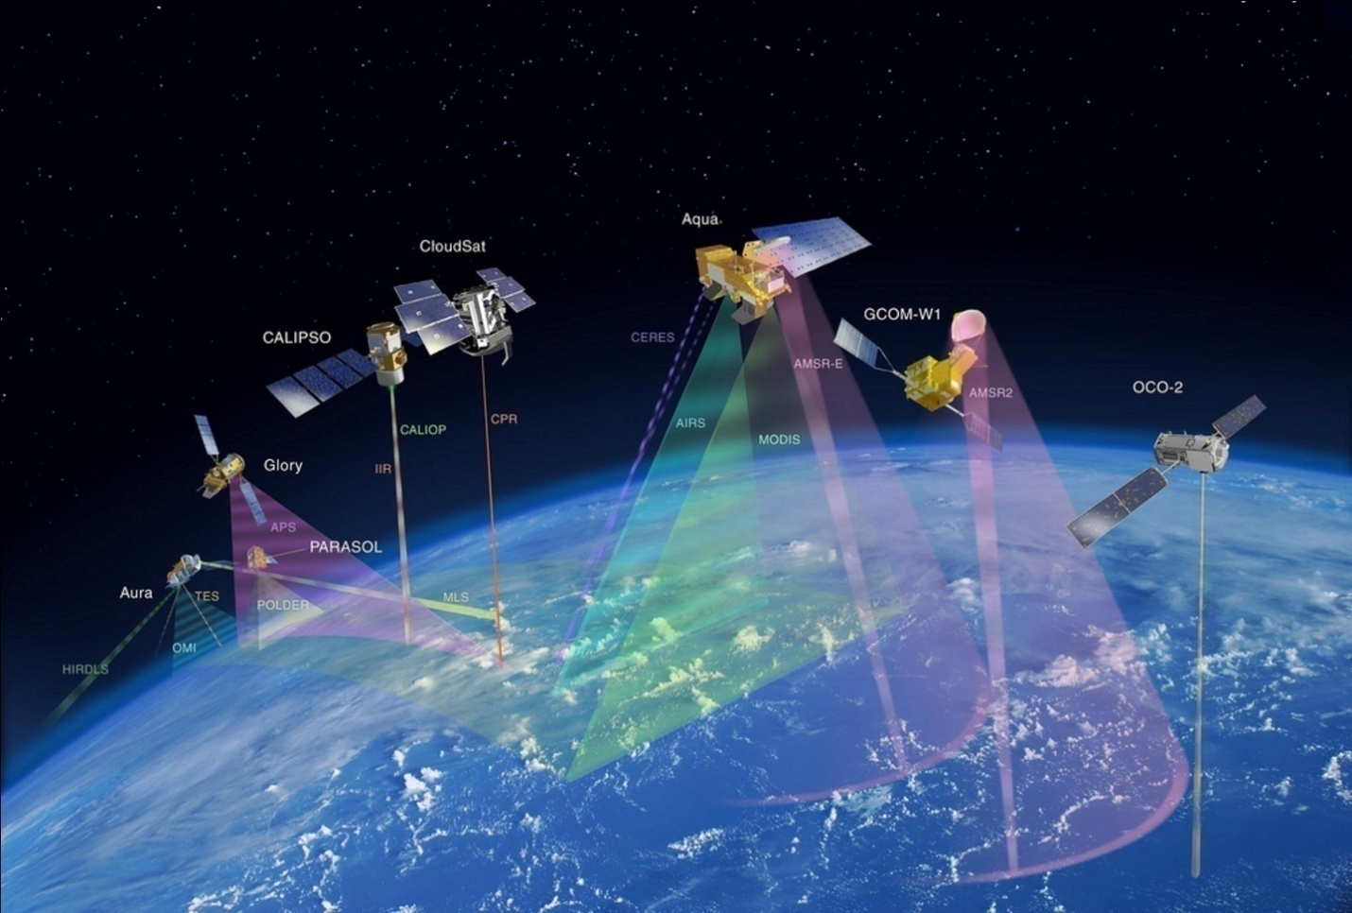
Services

Slide 26
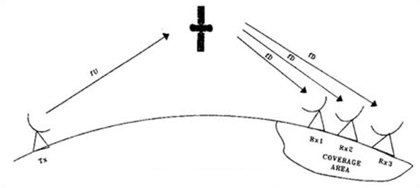
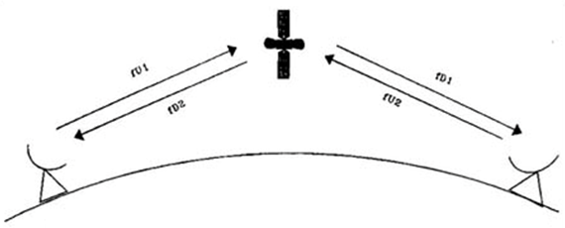
One way link
Different Satellite Communications
Two way link
Notes:
One way link from transmitter Tx to receiver Rx on earth’s surface
In two-way Satellite Communications link the exchange of information between two distant users takes place through a pair of transmit and receive earth stations and a satellite.

Slide 27
One-way satellite services are:
Broadcast Satellite Service: Radio, TV, Data broadcasting.
Safety services : Search & Rescue, Disaster Warning
Radio Determination Satellite Service(Position location)
Standard frequency and time signal satellite service
Space Research Service.
Space operations service.
Earth Exploration Satellite Service.
Notes:
Space operations service, (Tracking, Telemetry, Command)
Earth Exploration Satellite Service (Remote Sensing)
Standard frequency and time signal satellite service

Slide 28
Two-way satellite services are:
Fixed Satellite Service: Telephone, fax, high bit rate data etc.
Mobile Satellite Service: Land mobile, Marine time mobile, Aero-mobile, personal communications.
Satellite News Gathering.
Inter Satellite Service.
Notes:
A new class of two-way fixed satellite network service known as Very Small Aperture Terminal (VSAT) service has became very popular among business and closed users group communities.

